Slide 1

ALGHERO RACE HISTORY
Elite Analysis · Past 8 Years · May 2026
USA Triathlon High Performance

Slide 2
Key Course Differentiators
Alghero
ALGHERO
COURSE AT A GLANCE
[PLACEHOLDER: 2-3 sentences on what makes Alghero unique as a race venue — geography, setting, and character. E.g. 'Set on the Coral Riviera of Sardinia, the WTCS Alghero course combines crystal-clear Mediterranean waters, a flat coastal bike circuit, and a multi-lap run through the ancient walled city.']
Swim:
1.5 km
Bike:
40.5 km
Run:
10.0 km
Format:
Standard Triathlon
COURSE FEATURES
Bike Laps:
9
Run Laps:
4
• [PLACEHOLDER: Feature 1 — e.g. 'Open-water swim in the Bay of Alghero — calm seas']
QUICK LINKS
• [PLACEHOLDER: Feature 2 — e.g. 'Flat coastal bike circuit — fast and tactical']
Current Race Info:
[PLACEHOLDER: https://www.triathlon.org/events/event/2026_world_triathlon_championship_series_alghero]
• [PLACEHOLDER: Feature 3 — e.g. 'Multi-lap run through the historic city centre']
Last Year's Results:
https://www.triathlon.org/events/event/2025_world_triathlon_championship_series_alghero
• [PLACEHOLDER: Feature 4 — e.g. 'Hot Mediterranean conditions typical in late May']
Race Replay:
[PLACEHOLDER: https://triathlonlive.tv/ (TriathlonLIVE replay)]

Slide 3
Course Profile & Map
Alghero
[PLACEHOLDER: Insert upcoming course map or race photo here] Right-click → Replace Image, or paste screenshot of the World Triathlon course map PDF.
[PLACEHOLDER: Insert previous year course map or race photo here] Right-click → Replace Image, or paste screenshot of the World Triathlon course map PDF.
2026 Course
2025 Course
Source: [PLACEHOLDER: World Triathlon event page URL]
Source: https://www.triathlon.org/events/event/2025_world_triathlon_championship_series_alghero
Discipline | Distance | Laps | Terrain / Notes
Swim | 1.5 km | — | [PLACEHOLDER: e.g. Open-water, Bay of Alghero]
Bike | 40.5 km | 9 | [PLACEHOLDER: e.g. Flat coastal road circuit, closed course]
Run | 10.0 km | 4 | [PLACEHOLDER: e.g. Flat multi-lap, cobblestone city-centre finish]

Slide 4
Environmental Risk Profile
Alghero
RACE-DAY WEATHER (08:00–11:00 local)
AIR QUALITY (Open-Meteo archive)
Year | Date | Air Temp | Humidity | Wind km/h | Precip mm
2025 | May 31 | 27 | — | 9 | —
Year | PM2.5 | EU AQI | UV Index | Risk
2025 | — | — | — | —
HEALTH & WATER QUALITY RISK FACTORS
• Water Quality: [PLACEHOLDER: Historical water quality data for Alghero — e.g. bacterial counts, EU Bathing Water Directive status, known algae / pollution events. Check local environmental agency reports for May race window.]
• Athlete Health Incidents: [PLACEHOLDER: Any known GI illness, respiratory, or heat-related incidents at this or comparable venues. E.g. Sunderland 2023 — reported GI illness post-swim for multiple athletes.]
• Water Temperature: [PLACEHOLDER: Historical open-water temperature for Alghero in May (not available from Open-Meteo; check Copernicus Marine / NOAA or WT historical results).]
• Heat / Humidity Risk: Auto-derived from above table — flag if humidity >70% or air temp >25°C at race time.
Weather and AQ data: Open-Meteo historical archive (archive-api.open-meteo.com). EU AQI: Good ≤20, Fair ≤40, Moderate ≤60, Poor ≤80, Very Poor >80.

Slide 5
Who to Watch — Alghero Race Week
ELITE MEN
ELITE WOMEN
Top 3 by World Ranking (no startlist data yet)
Top 3 by World Ranking (no startlist data yet)
Rank | Athlete | Points
1 | Matthew Hauser | 6,706
2 | Miguel Hidalgo | 6,185
3 | Vasco Vilaca | 5,748
Rank | Athlete | Points
1 | Beth Potter | 7,144
2 | Lisa Tertsch | 6,661
3 | Leonie Periault | 5,939
Returning Podium Athletes on Startlist
Returning Podium Athletes on Startlist
None of last year's podium are on the current startlist.
None of last year's podium are on the current startlist.
Rankings = current World Triathlon rankings snapshot; startlist intersect uses program_entries when available.

Slide 6
ELITE MEN

Slide 7
Race Overview — Elite Men
Alghero
RACE HISTORY AT ALGHERO
3 KEYS TO SUCCESS
The Elite Men race at Alghero has been held 1 time in this analysis window (2025–2025). The event is staged as part of the World Championship Series calendar. [PLACEHOLDER: Add 1–2 sentences on notable storylines, competitive history, or what makes this event significant for Elite Men athletes. E.g. defending champions, record performances, dramatic finishes.]
1
Swim positioning matters — an average of 16 athletes exit the water within 15 sec of the leader. Entering the bike in the front pack is critical; conserve energy with a disciplined swim line rather than sprinting alone.
2
[PLACEHOLDER: Key 2 — Describe bike strategy: is this a pack race or do breakaways form? What power/tactics are needed to stay in the lead group?]
3
Run speed separates the podium — the fastest run pace averages ~3:00/km with a ~137s spread between fastest and average finisher. Either a pre-built lead from the bike or exceptional run speed is required to win.

Slide 8
Results Summary — Elite Men
Alghero
Year | Date | Category | Field | DNF/LAP/DNS | Winner | Winner Time | Air Temp | Water Temp | Swim km | Bike km | Run km
2025 | May 31 | World Championship Series | 43 | 11 | Hidalgo | 1:44:05 | 27 | 22 | 1.50 | 40.5 | 10.0

Slide 9
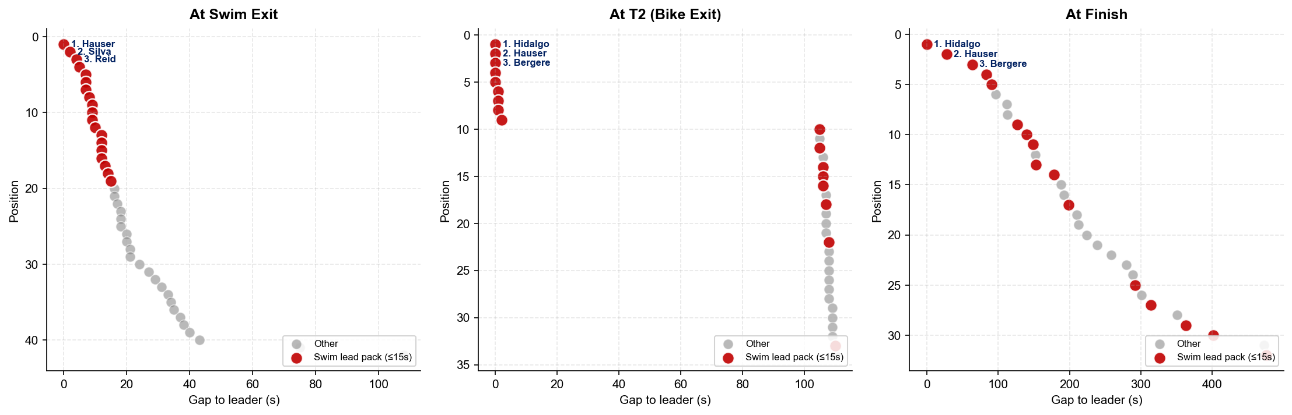
Pack Dynamics — Elite Men (2025)
Alghero
Each point = one athlete; position derives from elapsed time at the checkpoint. Red points are athletes who exited the swim within 15s of the leader — trace them across the three plots to see whether the early swim group held to the line.

Slide 10
Top Splits vs Season Norms — Elite Men (2025)
Alghero
Top 3 split times at this race vs each athlete's best and average split across WTCS Standard-distance races in the 12 months before the race.
SWIM
BIKE
RUN
Athlete | Split | Best | Avg | Δ Avg
M. Hauser | 17:12 | 17:26 | 17:38 | -26s
M. Silva | 17:14 | 19:10 | 19:10 | -116s
T. Reid | 17:16 | 17:57 | 18:38 | -82s
Athlete | Split | Best | Avg | Δ Avg
C. Paquet | 55:29 | 52:17 | 55:08 | +20s
L. Bergere | 55:30 | 52:07 | 54:49 | +41s
M. Hidalgo | 55:31 | 52:06 | 55:18 | +13s
Athlete | Split | Best | Avg | Δ Avg
D. Campo | 29:59 | — | — | —
H. Milner | 30:05 | 28:47 | 29:40 | +25s
M. Hidalgo | 30:09 | 30:04 | 30:33 | -24s
Best / Avg = athlete's WTCS Standard-distance splits in the 12 months ending the day before this race. Δ Avg = this race's split minus the athlete's 12-month average; green = faster than average, red = slower.

Slide 11
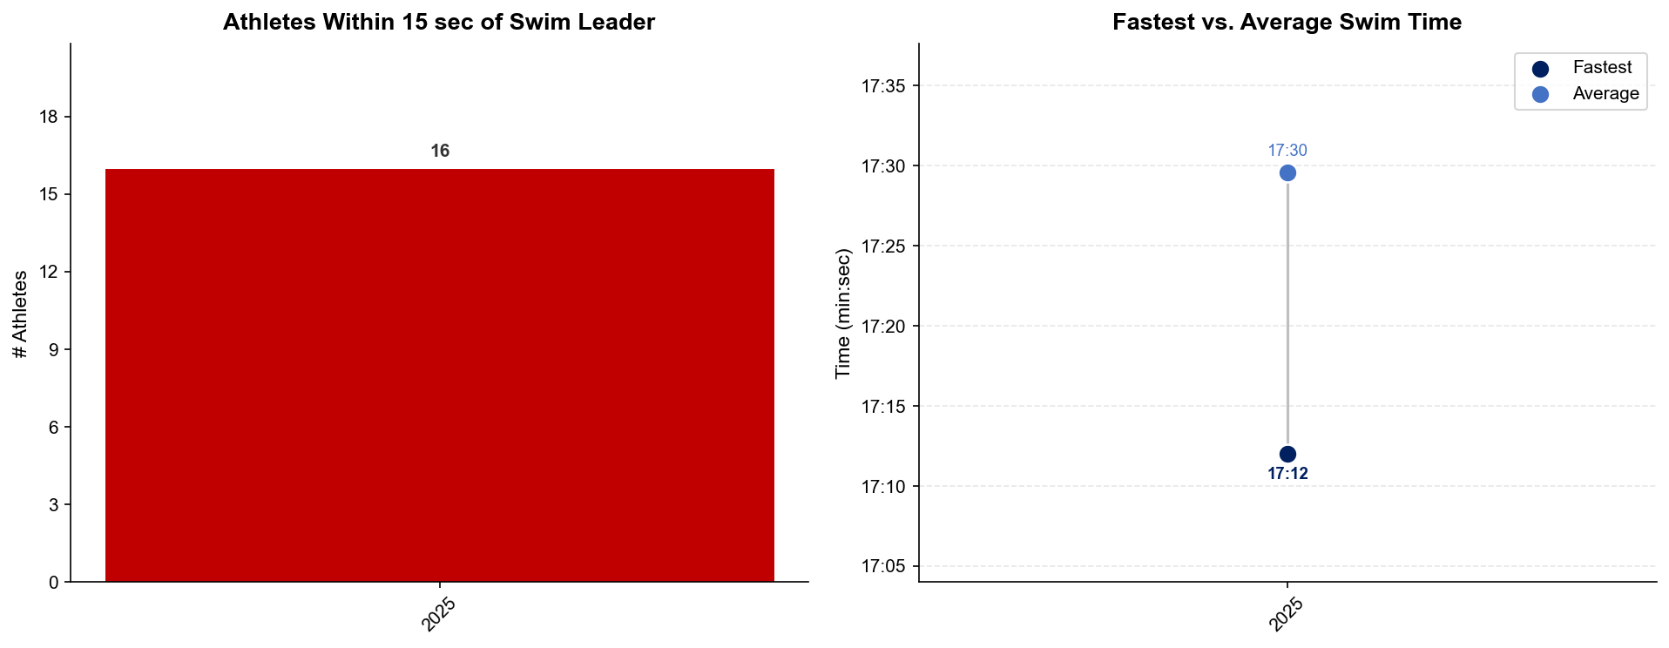
Swim Exit Dynamics — Elite Men
Alghero

Slide 12
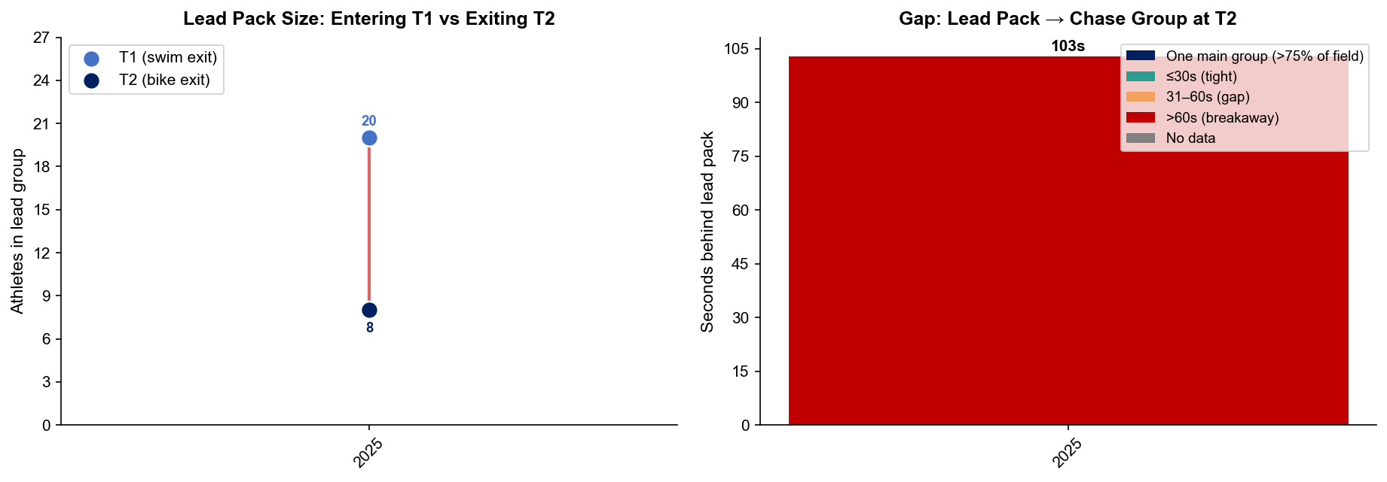
Bike Pack Evolution — Elite Men
Alghero
Lead pack = athletes within 15 sec of leader. T1 = lead group entering the bike; T2 = lead group exiting the bike.
Year | Lead Size @ T1 | Lead Size @ T2 | Change | Chase Group @ T2 | Chase Gap*
2025 | 20 | 8 | -12 | 24 | 103s
Lead pack = athletes within 15 sec of leader. Chase group = athletes within 15 sec of the first athlete outside the lead pack. * Chase Gap = seconds from the last lead-pack athlete to the first chase-group athlete at T2.
Dropouts: 2025: 10 DNF/LAP (4 in lead group at bike, t1)

Slide 13
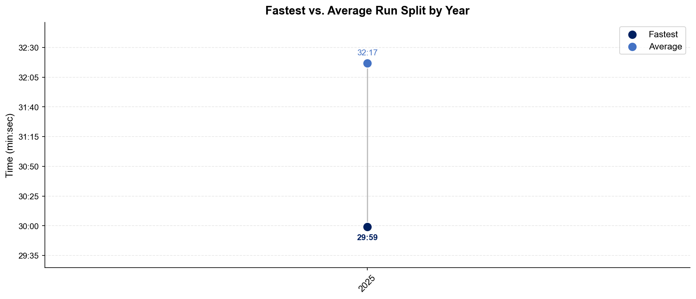
Run Split Analysis — Elite Men
Alghero

Slide 14
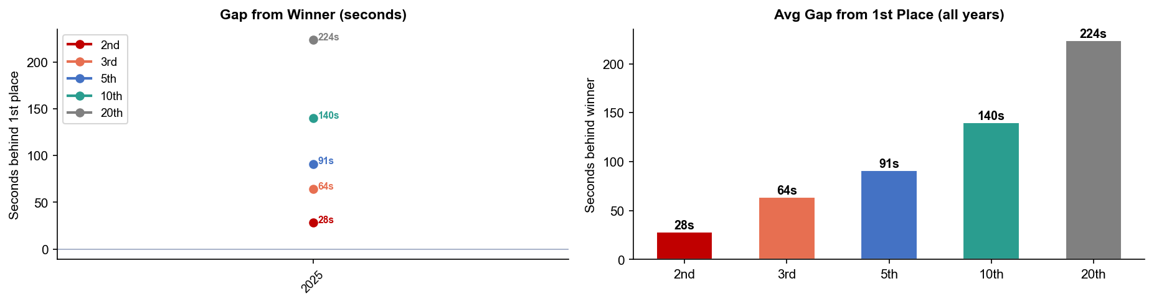
Key Position Times — Elite Men
Alghero
Year | 1st | 2nd | 3rd | 5th | 10th | 20th
2025 | 1:44:05 | 1:44:33 +28s | 1:45:09 +64s | 1:45:36 +91s | 1:46:25 +140s | 1:47:49 +224s

Slide 15
Race Conditions — Elite Men
Alghero
Year | Date | Air Temp | Humidity | Wind (km/h) | Precip (mm) | Water Temp | Wetsuit | Conditions
2025 | May 31 | 27 | — | 9 | — | 22 | forbidden | —
Air temp, humidity, wind, and precipitation sourced from Open-Meteo historical archive (race window 08:00–11:00 local) where WT API data is absent. Values marked * are Open-Meteo estimates. Water temp and wetsuit ruling are from the World Triathlon API per program.

Slide 16
ELITE WOMEN

Slide 17
Race Overview — Elite Women
Alghero
RACE HISTORY AT ALGHERO
3 KEYS TO SUCCESS
The Elite Women race at Alghero has been held 1 time in this analysis window (2025–2025). The event is staged as part of the World Championship Series calendar. [PLACEHOLDER: Add 1–2 sentences on notable storylines, competitive history, or what makes this event significant for Elite Women athletes. E.g. defending champions, record performances, dramatic finishes.]
1
Fast swimming is decisive — only ~7 athletes typically leave the water together. A strong swim directly builds a race-winning gap before T1.
2
[PLACEHOLDER: Key 2 — Describe bike strategy: is this a pack race or do breakaways form? What power/tactics are needed to stay in the lead group?]
3
Run speed separates the podium — the fastest run pace averages ~3:25/km with a ~141s spread between fastest and average finisher. Either a pre-built lead from the bike or exceptional run speed is required to win.

Slide 18
Results Summary — Elite Women
Alghero
Year | Date | Category | Field | DNF/LAP/DNS | Winner | Winner Time | Air Temp | Water Temp | Swim km | Bike km | Run km
2025 | May 31 | World Championship Series | 39 | 7 | Beaugrand | 1:55:55 | 28 | 21.8 | 1.50 | 40.5 | 10.0

Slide 19
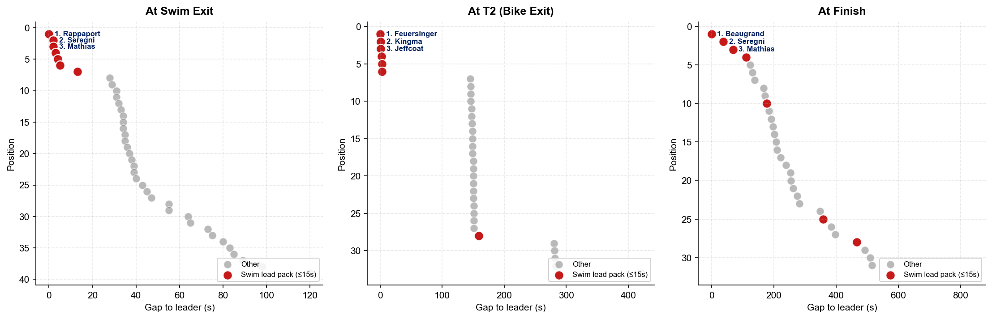
Pack Dynamics — Elite Women (2025)
Alghero
Each point = one athlete; position derives from elapsed time at the checkpoint. Red points are athletes who exited the swim within 15s of the leader — trace them across the three plots to see whether the early swim group held to the line.

Slide 20
Top Splits vs Season Norms — Elite Women (2025)
Alghero
Top 3 split times at this race vs each athlete's best and average split across WTCS Standard-distance races in the 12 months before the race.
SWIM
BIKE
RUN
Athlete | Split | Best | Avg | Δ Avg
S. Rappaport | 18:25 | 22:17 | 22:17 | -232s
B. Seregni | 18:27 | 19:40 | 20:50 | -142s
O. Mathias | 18:27 | 22:09 | 22:09 | -222s
Athlete | Split | Best | Avg | Δ Avg
M. Kingma | 1:01:31 | — | — | —
T. Feuersinger | 1:01:35 | 57:18 | 57:18 | +257s
C. Beaugrand | 1:01:36 | 59:48 | 59:48 | +108s
Athlete | Split | Best | Avg | Δ Avg
L. Periault | 34:10 | 33:24 | 34:56 | -46s
L. Tertsch | 34:24 | 33:10 | 33:27 | +57s
J. Lehair | 34:32 | 33:41 | 34:32 | 0s
Best / Avg = athlete's WTCS Standard-distance splits in the 12 months ending the day before this race. Δ Avg = this race's split minus the athlete's 12-month average; green = faster than average, red = slower.

Slide 21
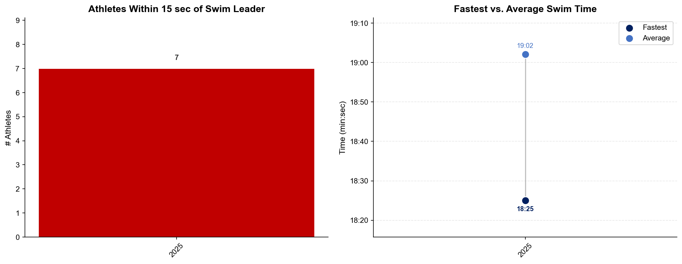
Swim Exit Dynamics — Elite Women
Alghero

Slide 22
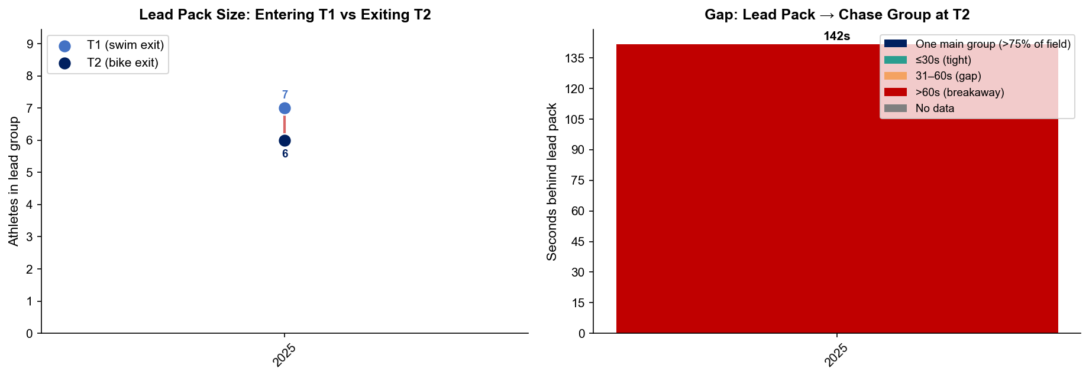
Bike Pack Evolution — Elite Women
Alghero
Lead pack = athletes within 15 sec of leader. T1 = lead group entering the bike; T2 = lead group exiting the bike.
Year | Lead Size @ T1 | Lead Size @ T2 | Change | Chase Group @ T2 | Chase Gap*
2025 | 7 | 6 | -1 | 21 | 142s
Lead pack = athletes within 15 sec of leader. Chase group = athletes within 15 sec of the first athlete outside the lead pack. * Chase Gap = seconds from the last lead-pack athlete to the first chase-group athlete at T2.
Dropouts: 2025: 7 DNF/LAP

Slide 23
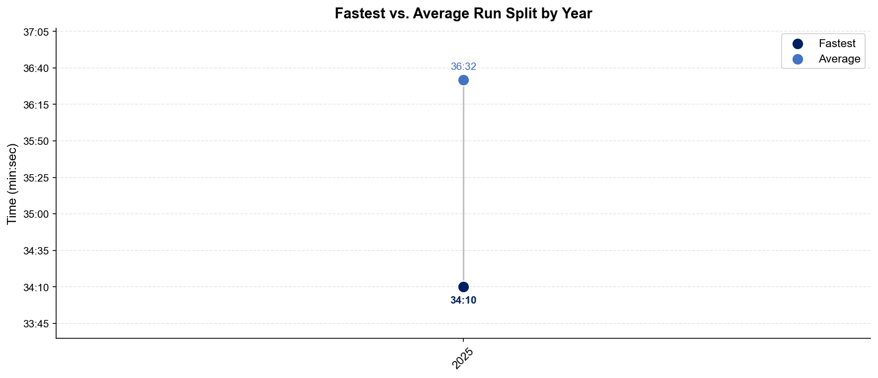
Run Split Analysis — Elite Women
Alghero

Slide 24
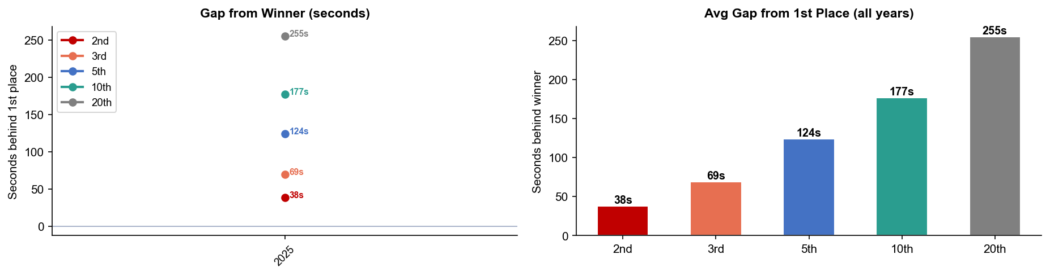
Key Position Times — Elite Women
Alghero
Year | 1st | 2nd | 3rd | 5th | 10th | 20th
2025 | 1:55:55 | 1:56:33 +38s | 1:57:04 +69s | 1:57:59 +124s | 1:58:52 +177s | 2:00:10 +255s

Slide 25
Race Conditions — Elite Women
Alghero
Year | Date | Air Temp | Humidity | Wind (km/h) | Precip (mm) | Water Temp | Wetsuit | Conditions
2025 | May 31 | 28 | — | 9 | — | 21.8 | forbidden | —
Air temp, humidity, wind, and precipitation sourced from Open-Meteo historical archive (race window 08:00–11:00 local) where WT API data is absent. Values marked * are Open-Meteo estimates. Water temp and wetsuit ruling are from the World Triathlon API per program.

